Slide 1
GRA Demonstration Meetings - Kickoff
MAJIC Agency Stakeholders
Anchorage, Alaska
December 17, 2012
Scott Came
Deputy Executive Director
SEARCH

Slide 2
Agenda and Introductions

Slide 3
GRA Background
Reference Architecture for justice information exchange
Developed by Global Justice Information Sharing Initiative 2007-2011
Grew out of architectures in jurisdictions
Washington
Pennsylvania
Electronic Court Filing standard
Leverages industry standards and methodologies (IBM, Microsoft, others)
Notes:
Reference architecture – model architecture designed to be used as the basis for a jurisdiction/project architecture
If enough time in session…ask how many participants have an architecture for their jurisdiction’s initiative. Then talk about why architecture is useful, benefits of SOA:
Better (more efficient, consistent) decision-making about technology investments
More agile, responsive, future-proof solutions/technology
Awareness of Global? Group of groups; FACA; working groups that have developed functional and technical standards

Slide 4
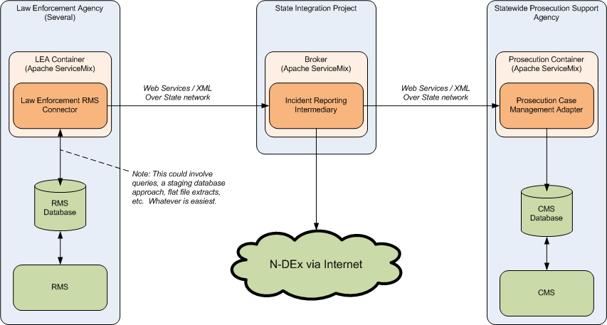
Sample GRA Exchange

Slide 5
Why should I conform?
Acquire open, non-proprietary systems
Greater ability to share data with a wider range of sources
Lower lifetime cost, less lock-in
Benefit of industry standards without as much hard work
RFPs are easier to write
Interoperate with other conformant systems/jurisdictions
More grant opportunities (3 of 6 categories in this year’s BJA JIS solicitation mentioned the GRA)
Notes:
Start with a brief discussion of what conformance means

Slide 6
GRA Conformance Targets
Services
Exchanges (service “actions”)
Infrastructure (“execution context”)

Slide 7
Services
Component that provides access to a capability through one or more closely related information exchanges
A conformant service:
Is properly identified (follows the guidelines in the GRA Guidelines for Identifying and Designing Services)
Is properly documented (follows the structure and conventions in the Service Specification Package Guidelines)

Slide 8
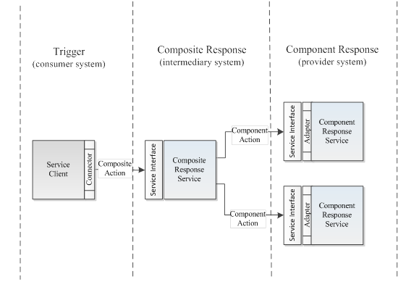
General Information Flow Model

Slide 9
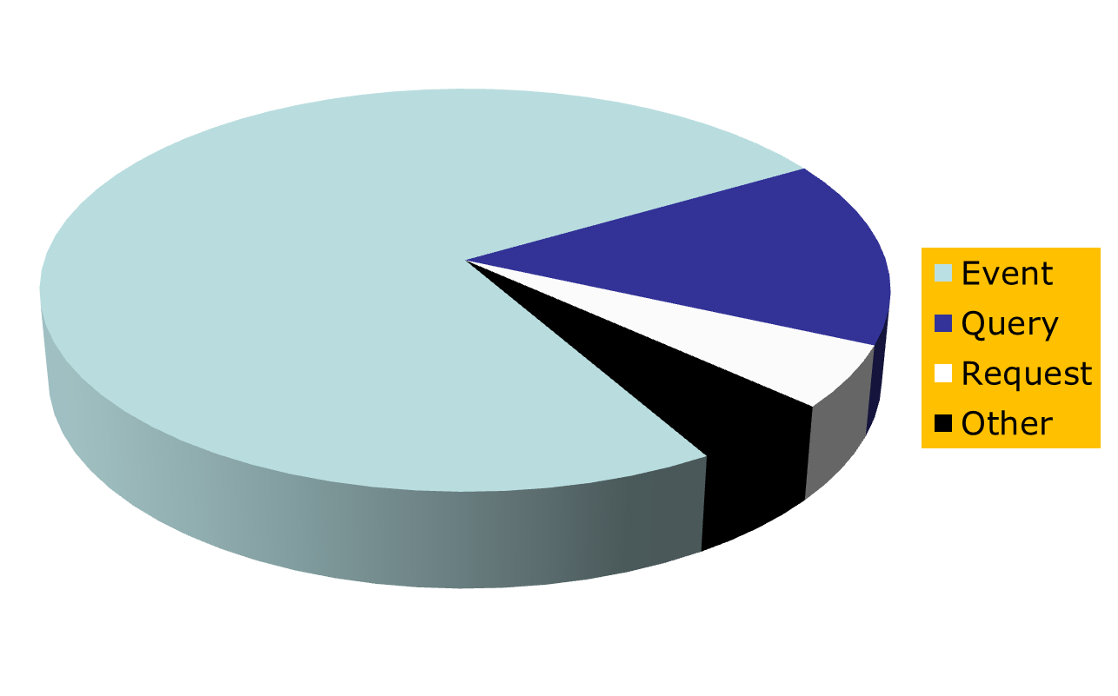
Information Flow Model Archetypes
Notes:
Discuss the distinction of each in the remainder of the slide deck

Slide 10
Event-Driven
Event-Driven Archetype
Information exchange begins with the occurrence of a real-world business event that is either citizen-initiated (e.g., an arrest) or procedural (e.g., sentencing an offender).
The composite response under this archetype represents the enterprise response or “handling” of this event, which generally involves orchestrating individual agency component responses.

Slide 11
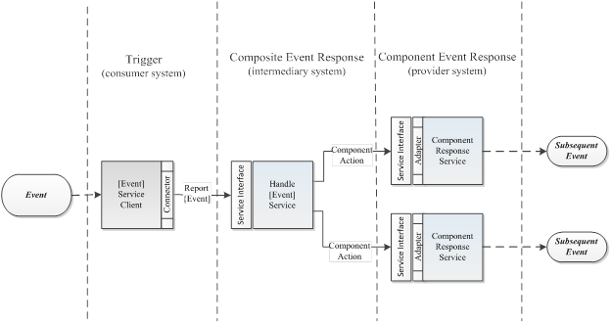
Event-Driven Information Flow Model

Slide 12
Event-Driven Model Component Actions
Event-Driven Component Actions
Action | Description | Examples
File | Deposit of information for the purpose of establishing some sort of case or request. | File Criminal Case, File Felony Charges, File Complaint
Update | To change or modify stored information | Update Criminal History
Record | To store information for future access. | Record Arrest Warrant, Record Booking Report
Remove | The termination of an individual’s association with an organization or process, etc. | Remove Warrant, Remove Arrest Report
Issue | To formally distribute information expecting that some sort of physical action will be taken. | Issue Arrest Warrant, Issue Summons, Issue Warning
Notify | To distribute information based on a need for awareness. | Notify of Intake, Notify of Booking
Submit | To provide information to the power or authority of another through policy (process) or law. Submit is usually associated with a deference to a judgment, opinion, decision or analysis. | Submit Arrest Report, Submit Progress Report
Notes:
Super simple example

Slide 13
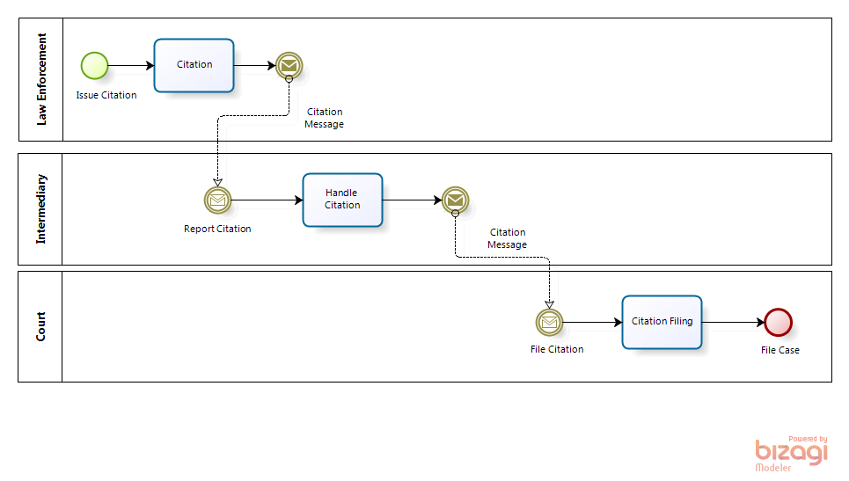
Citation Event Example
Notes:
Super simple example

Slide 14
Query-Driven
Query-Driven Archetype
Information flow begins with a practitioner’s or citizen’s desire to know information about the state or history of the justice system (including events that occurred and any responses to those events).
The composite response under this archetype represents the enterprise effort to gather the requested information from one or more component data sources and assemble the component responses into a single, enterprise response to the requestor.

Slide 15
Query-Driven Information Flow Model - Query

Slide 16
Query-Driven Information Flow Model – Query Response

Slide 17
Query-Driven Information Flow Model – Component Actions
Query-Driven Component Actions
Query Actions |  |  | Query Response Actions
Action | Description | Examples | Action | Examples
[Subject] Query | An Query to a single system for information on a subject (person, place, thing) based on initial criteria. | Query Location | [Subject] Query Response | Query Location Response
[Subject] Federated Query | A Query to multiple systems for information on a subject (person, place, thing) based on initial criteria. | Person Federated Search, Automobile Federated Search | [Subject] Federated Query Response | Person Search Response, Automobile Search Response
Identify [Subject] | To confirm or deny the identity of a subject. | Identify Person, Identify Organization | [Subject] Identification | Person Identification, Organization Identification
Verify [Subject] | To confirm or deny the identity of a subject through a comparison of 2 or more data. | Verify Person with Fingerprints | [Subject] Verification | Person with Fingerprints Verification
Note: Each Query must have a Query Response

Slide 18
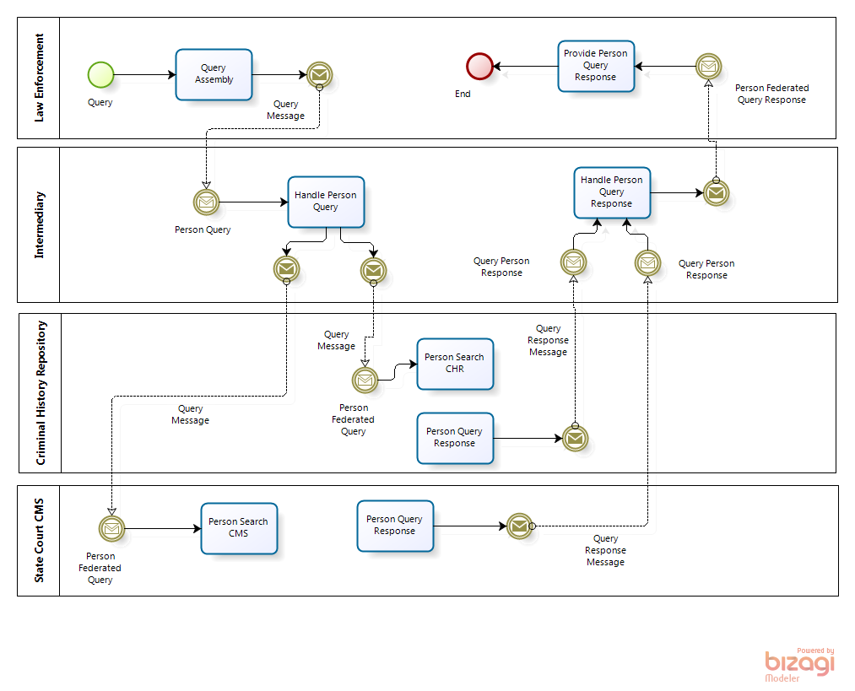
Person Federated Query Example
Notes:
Federated query, synchronous

Slide 19
Request-Driven
Request-Driven Archetype
Exchange is triggered by a practitioner’s desire to effect some state change in the collective environment.
The initial exchange is with a composite request intermediary, which in turn exchanges information with component request services.
These exchanges could be one-way or request-response, and if request-response could be synchronous or asynchronous.

Slide 20
Request-Driven Information Flow Model

Slide 21
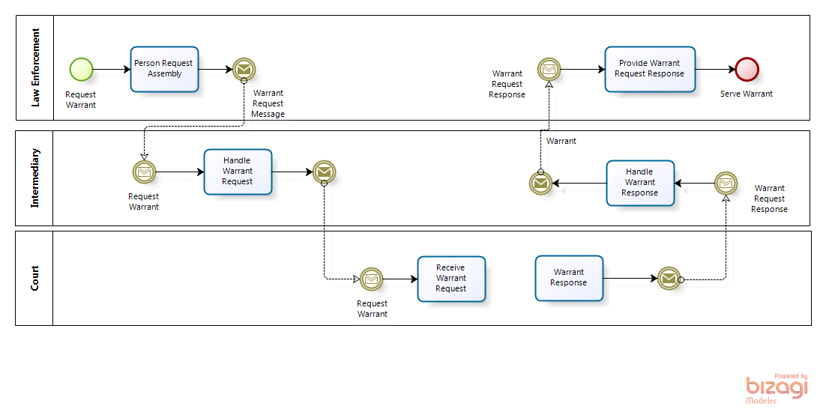
Warrant Request/Reply Example

Slide 22
Exchange
Action that a service performs
Protocol for interaction with a service
A conformant exchange (action):
Follows the rules expressed in a GRA Service Interaction Profile (SIP); in practice, this means “WSDL first” web services
Has a NIEM-conformant information model

Slide 23
Infrastructure
In GRA terms, “execution context”
Network, hardware, and software that supports service interaction
Conformant execution context provides:
A container environment for connectors (consumer or initiator of interaction)
A container environment for adapters (provider or recipient of interaction)
A container environment for intermediaries
Security, availability, performance, and reliability

Slide 24
Global Information Sharing Toolkit (GIST)
Collection of Global’s “normative” products:
Global Reference Architecture (GRA)
Global Federated Identity and Privilege Management (GFIPM) tools
Global Technical Privacy Framework
Reference Service Specifications
Template for a state’s justice information sharing architecture
NIEM and IEPDs are not enough to ensure interoperability and reuse!
Notes:
Discussion notes for GIST:
-- Governance guidelines - decision-making, prioritization of work, provisioning of infrastructure, etc.
-- Methodology for designing information sharing systems according to SOA principles
-- Profiling of industry standards
-- Guidance on establishing federated identity management and automated privacy policy enforcement

Slide 25
GIST Conformance in a Nutshell
NIEM conformant exchanges
GRA conformance
Use “WSDL first” WS-*
Avoid point-to-point exchanges
Enterprise-wide infrastructure that supports the standards
Services conform to design principles
GFIPM conformance
Avoid new centralized user / credential stores
Services and applications trust users’ agencies’ authentication

Slide 26
Thank you!
Scott Came
Deputy Executive Director
SEARCH
scott@search.org
916-212-5978

