Slide 1
Decoding the Alphabet Soup: Global JIS Standards 101

Slide 2

?
Why is information sharing important in the Criminal Justice System?

Slide 3
  Justice Information Sharing is at the heart of everything we need to do to prevent terrorism, reduce crime and improve the quality of justice in America.

Slide 4
Having access to information improves decision making…
  Tactical decisions in the field
  Operational decisions on deployment of resources
  Threat assessment and actionable intelligence
  Management decisions on crime control and public safety strategies
  Executive and legislative decisions on public policy issues

Slide 5
  Information can flow automatically between systems
  Greater efficiency by eliminating redundant data entry & reuse
  Improved information quality by reducing human error
  Access control, accountability and auditing
Notes:
Only way information is going to flow automatically between systems is by using standards.

Slide 6
Support for research, evaluation and strategic planning
  More useful data sets from multiple sources
  More accurate performance measures
  Better program evaluations
  More opportunity for reliable applied research
  Data based planning & strategies
Notes:
The extent to which ROI and cost benefit can be established, plays into the sustainment argument.

Slide 7
And, of course, the bottom line
  The use of standards based information sharing technology provides for …
  Efficiencies in development
  Future Interoperability
  Reusability and Scalability
  Agility and Flexibility
Notes:
The extent to which ROI and cost benefit can be established, plays into the sustainment argument.

Slide 8

How is all this possible?

Slide 9
What is “Global”?
A Federal Advisory Committee created to support the broad scale exchange of justice and public safety information.
Promotes standards-based electronic information exchange to provide the justice community with timely, accurate, complete, and accessible information in a secure and trusted environment.
Committed to a “National” strategy (not a “federal” strategy)
Notes:
The Global Justice Information Sharing Initiative (Global) serves as a Federal Advisory Committee (FAC) and advises the U.S. Attorney General on justice information sharing and integration initiatives.
Global is a ''group of groups,'' representing more than 32 independent organizations, spanning the spectrum of law enforcement, judicial, correctional, and related bodies.
To help steer and facilitate Global efforts, the U.S. Attorney General reached out to key personnel from local, state, tribal, federal, and international justice entities to form the Global Advisory Committee (GAC).
GAC's efforts have direct impact on the work of more than 1.2 million justice professionals and positions Global to impact citizens of the United States, Canada, and beyond.

Slide 10

Global Advisory Committee (GAC)
Consensus Building, Trust and Collaboration
Notes:
Global was created to support the broad scale exchange of pertinent justice and public safety information.
Global's mission--the efficient sharing of data among justice entities--is at the very heart of modern public safety and law enforcement.
Global promotes standards-based electronic information exchange to provide the justice community with timely, accurate, complete, and accessible information in a secure and trusted environment.
Member organizations participate in Global with a shared responsibility and shared belief that, together, they can bring about positive change by making recommendations and supporting the initiatives of the U.S. Department of Justice (DOJ).
The work of GAC has implications of the highest importance--making it the foremost voice for justice information sharing.

Slide 11
Global Membership
Consisting of Justice Information stakeholder agencies, associations, and constituencies representing…
All levels of government: local, Tribal, county, state and federal
All components of the justice system: law enforcement, prosecution, courts and corrections
Justice stakeholders: victim advocates, juvenile justice advocates, public defender and treatment providers
Other interested stakeholders: homeland security, motor vehicle administrators, Interpol, and the IT industry (IJIS Institute)

Slide 12
Justice Information Sharing:
The Challenges
Numerous autonomous justice organizations
Multiple trust domains
Heterogeneous technology environments
Varied governance structures
Significant investment in legacy environments
Inconsistent or non-existent policies & procedures
Disparate, incompatible or non-existent security mechanisms

Slide 13
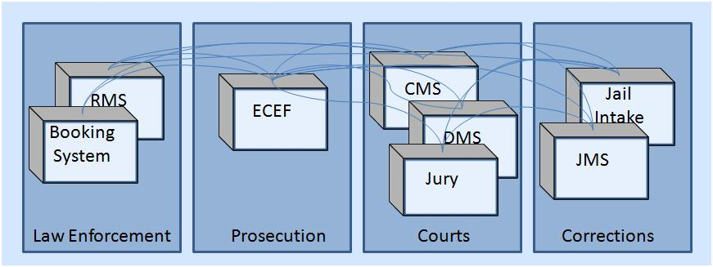
Silos of Justice Information
Existing systems are mostly custom built to meet existing needs, use customized means for integration, and exemplify standalone “silos” of data, making it costly to share information.

Slide 14




The evolution of information sharing…
Global
Information
Sharing
Tools

Slide 15

The Nuts and Bolts of Information Sharing Standards….

Slide 16
The Anatomy of an Information Sharing System:
Business and technical architectures, e.g., operational capabilities, rules, etc., and technologies, e.g., hardware, software, networks, etc.
A method to secure data, manage users, and ensure controlled access
A strategy to meet the complex challenges of protecting privacy, civil liberties, and civil rights
Policies, agreements, contracts or laws governing information sharing
“Dictionaries” and “vocabularies” used to store and interpret data
Security
Governance
Data Model
Architecture
Privacy

Slide 17
What the Global Justice Information Sharing Tool Kit is NOT…
Not an off the shelf software application
Not a “Plug and Play” resource
Not a “One Size Fits All” solution
Not a “Just Add Water” instant tool.

Slide 18
The Global Tool Kit…
A Standards Based Approaches to Information Sharing
NIEM Users’ Guide
GRA Specifications
Privacy Policy Guidelines Templates
Governance
Statement of Participation
Service Level Agreement(s)
National Information Exchange Model (NIEM)
Global Reference Architecture (GRA)
Data
Security
Global Federated Identity & Privilege Management (GFIPM)
Privacy Policy Technical Framework
Privacy
NIEM Naming and Design Rules (NDR)
NIEM Conformance
Information Exchange Package (IEP)
Information Exchange Package Documentation (IEPD)
Technology
GRA Implementation Guidelines
Guidelines for Identifying and Designing Services
GRA Execution Context Guidelines
GRA Service Interaction Profiles
Privacy and Civil Liberties Impact Assessment Templates
GFIPM Metadata Specification
GFIPM Operational Policies and Procedures
GFIPM Governance Guidelines

Slide 19
National Information Exchange Model (NIEM)
  National Information MExchange odel (NIEM)
    NIEM Users’ Guide
    NIEM Naming and Design Rules (NDR)
    NIEM Conformance
    Information Exchange Package (IEP)
    Information Exchange Package Documentation (IEPD)
​A model that is used as a consistent baseline for creating information exchanges
the sender and receiver of information share a common, unambiguous understanding of the meaning of that information.
information is well understood and carries the same consistent meaning across various communities, thus allowing interoperability to occur.
Notes:
NIEM Users Guide

Slide 20
Global Reference Architecture (GRA)
  Global Reference Architecture (GRA)
    GRA Specifications
    GRA Implementation Guidelines
    Guidelines for Identifying and Designing Services
    GRA Execution Context Guidelines
    GRA Service Interaction Profiles
Service Oriented Architecture
Systems are “insulated” from one another, removing direct dependencies while making certain information visible.
Information sharing projects follow well-established open standards whenever possible, rather than solutions proprietary to particular vendors.
Adopts enterprise architecture using a common approach and a common technology infrastructure, rather than doing things on a project- or agency-specific basis..
    GRA Specifications
    GRA Implementation Guidelines
    Guidelines for Identifying and Designing Services
    GRA Execution Context Guidelines
    GRA Service Interaction Profiles
Notes:
GRA Specifications
GRA Implementation Guidelines
Guidelines for Identifying and Designing Services
GRA Execution Context Guidelines
GRA Service Interaction Profiles

Slide 21
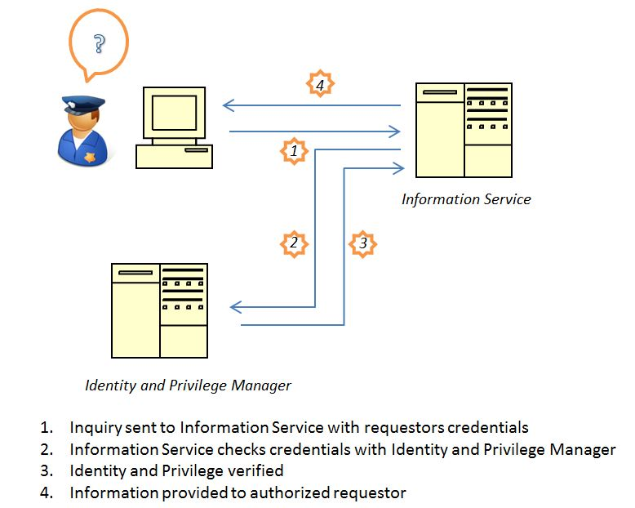
Global Federated Identity & Privilege Management (GFIPM)
  GFIPM Metadata Specification
  Operational Policies and Procedures
  Governance Guidelines
  Global Federated Identity & Privilege Management (GFIPM)
  GFIPM Metadata Specification
  GFIPM Operational Policies and Procedures
  GFIPM Governance Guidelines
Notes:
Identity and Privilege Metadata Specification
Operational Policies and Procedures
Federated Governance Guidelines

Slide 22
Protection of Privacy
  Privacy Policy Technical Framework
  Privacy Policy Guidelines Templates
  Privacy and Civil Liberties Impact Assessment Templates
Privacy Policy Technical Framework
Privacy Policy Guidelines Templates
Privacy and Civil Liberties Impact Assessment Templates

Slide 23
Governing Information Sharing
  Statement of Participation
  Service Level Agreement(s)
Statement of Participation
Service Level Agreement(s)
Federation Management

Slide 24

Global Justice Information Sharing Toolkit (GIST)
http://www.it.ojp.gov/gist

Slide 25
The Evolution of Global Standards
Global Advisory Committee adopts Working Group Recommendations
Global Standards Council (GSC) established to manage standards for implementation
    GSC developed the Global Standards Package (GSP) to promote consistency and interoperability of systems across the justice and public safety community
        OJP requires grantee compliance to the GSP and all components thereof.

Slide 26
Why are Standards Relevant?
  Standards are a common and repeated rules, conditions, guidelines or characteristics for products or related processes and production methods, and related management practices.
      Foundational standards specify technical methodologies and design characteristics to implement information sharing and safeguarding capabilities into systems and foster interoperability
        Example: National Information Exchange Model (NIEM)
      Functional standards describe business rules and conditions for use of standards within a specific business context
        Example: Suspicious Activity Reporting

Slide 27
Primary GSP Foundational Standards
National Information Exchange Model (NIEM)
Global Reference Architecture (GRA)
Global Federated Identity and Privilege Management (GFIPM)
Technical Privacy Framework
Notes:
GSP components enable the development of national, or “reference” specifications that further promote reuse for enhanced interoperability
National Information Exchange Model (NIEM) – NIEM helps to eliminate confusion associated with different data definitions across law enforcement, public safety and other justice organizations by providing a common vocabulary to ensure consistency and understanding among State, federal and local agencies when information is shared.
The Global Reference Architecture (GRA) - The GRA provides a reference architecture to speed agency adoption of Service-Oriented Architecture (SOA)-based approaches to information sharing, which will facilitate common messaging standards between information sharing systems.
Global Federated Identity and Privilege Management (GFIPM) – (pronounced “GEE – FIP - EM”) The GFIPM specifications and guidelines are designed to support security controls when accessing justice information systems, based on commonly understood and applied user access control policies

Slide 28
OJP Special Condition Language
“In order to promote information sharing and enable interoperability among disparate systems across the justice and public safety community, OJP requires the grantee to comply with DOJ’s Global Justice Information Sharing Initiative (DOJ’s Global) guidelines and recommendations for this particular grant. Grantee shall conform to the Global Standards Package (GSP) and all constituent elements, where applicable, as described at: http://www.it.ojp.gov/gsp_grantcondition “

Slide 29
OJP Special Condition Language (cont.)
“Grantee shall document planned approaches to information sharing and describe compliance to the GSP and appropriate privacy policy that protects shared information, or provide detailed justification for why an alternative approach is recommended.”

Slide 30
Compliance with GSP
Compliance to the GSP requires conformance to all components of the GSP whenever applicable.
If the grantee is planning to exchange information across agencies or systems using a common data format, such format is required to be conformant to the National Information Exchange Model (NIEM).
If the grantee is planning to adopt a service-oriented approach to sharing information, it must leverage the Global Reference Architecture (GRA), and so on.
If the grantee is planning to establish an identity management of information access control solution across agencies, the Global Federated Identity and Privilege Management method should be employed

Slide 31
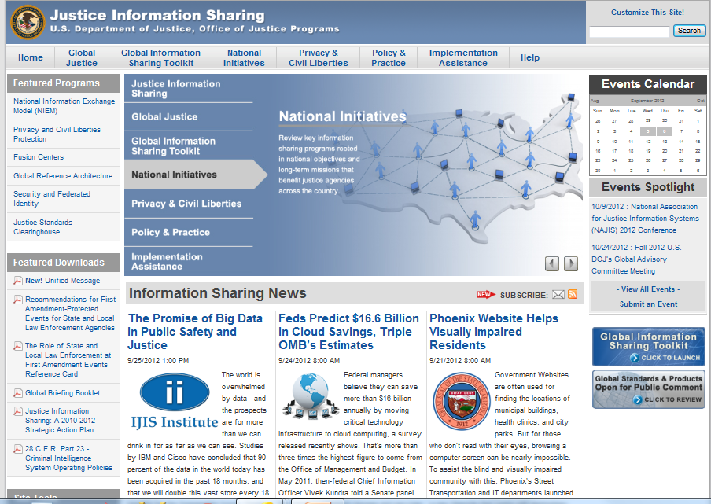
www.it.ojp.gov –
OJP Justice Information Sharing Web Site
Notes:
All of the Global resources discussed, as well as many others, are available online at the Office of Justice Programs (OJP) Information Technology (IT) Initiatives Web site: www.it.ojp.gov
The OJP IT Web site enables justice agencies to obtain timely and useful information on computer system integration processes, initiatives, and technology developments.

Slide 32
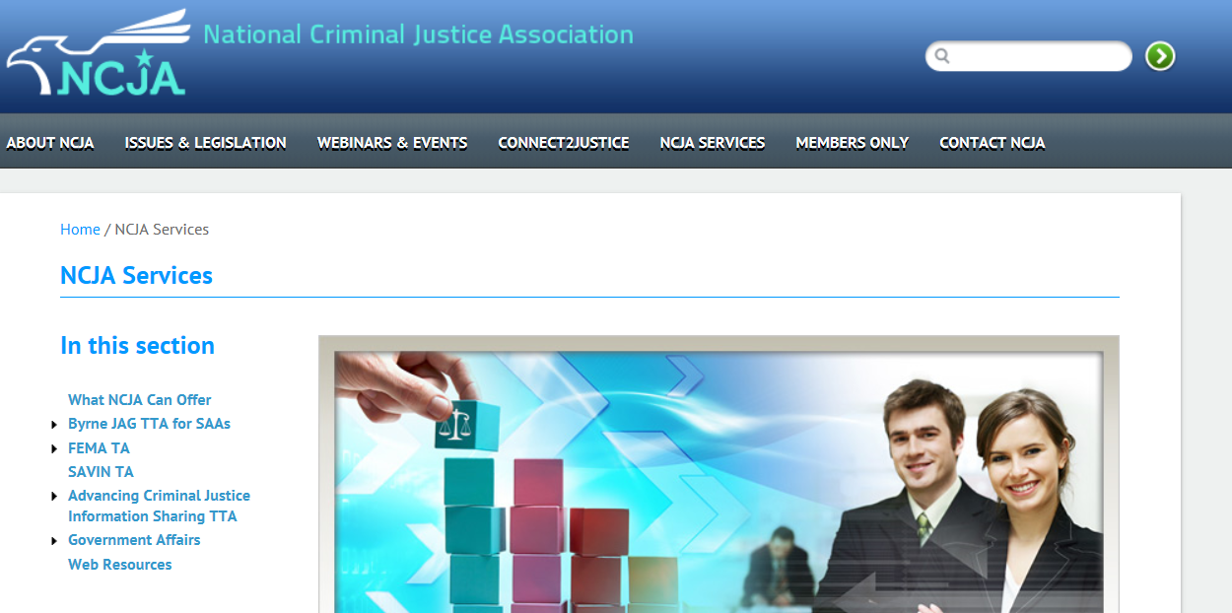
NCJA Technical Assistance

Slide 33

Questions?
This project was supported by Grant No. 2012-DP-BX-K004 awarded by the Bureau of Justice Assistance. The Bureau of Justice Assistance is a component of the Office of Justice Programs, which also includes the Bureau of Justice Statistics, the National Institute of Justice, the Office of Juvenile Justice and Delinquency Prevention, and the Office for Victims of Crime. Points of view or opinions in this document are those of the author and do not represent the official position or policies of the United State Department of Justice.

